Slide 1


ROS Workshop
-Lecture 4-
Python - Raspberry Pi - Robot Operating System
Husnu Melih Erdogan
Lab Assistant
Intelligent Robotics Lab

Slide 2

Course Structure
Lecture 4 - (Spring – Week 8)
ROS Parameter Server
roparam
ROS parameters and launch file
ROS parameters in Python
Lecture 5 - (Spring – Week 9)
ROS services
URDF
TF
Rviz
Lecture 1 – (Spring - Week 1)
What is ROS?
Introduction to ROS
ROS architecture, philosophy, history
How to install ROS?
Python basics
Examples
Lab Assignment 1
Lecture 2 – (Spring - Week 2)
Linux Basics
ROS commands
Getting familiar with the ROS filesystem
How to create a ROS package?
How to build a ROS package?
How to install released ROS packages?
How to build packages from source?
Lab Assignment 2
Lecture 3 - (Spring - Week 3)
ROS Nodes Detail
ROS Topics Detail
Writing a Publisher and Subscriber
ROS Launch
Lab Assignment 3

Slide 3
ROS Launch
roslaunch is a tool for easily launching multiple ROS nodes locally and remotely
It also allows you to set parameters on the Parameter Server.
How to run a launch file:
roslaunch package_name file.launch

Slide 4
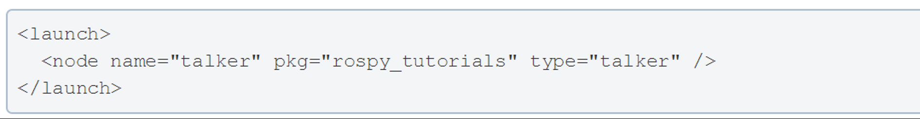
Simple ROS Launch File

Slide 5
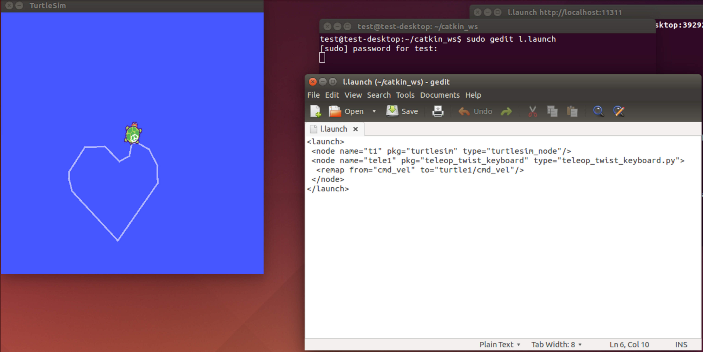
Launch File Example

Slide 6
ROS Parameter Server
A parameter server is a shared, multi-variate dictionary that is accessible via network APIs.
In addition to the messages, ROS provides another mechanism called parameters to get information to nodes.
The idea is that a centralized parameter server keeps track of a collection of values—things like integers, floating point numbers, strings, or other data
Nodes use this server to store and retrieve parameters at runtime.
As it is not designed for high-performance, it is best used for static, non-binary data such as configuration parameters.
It is meant to be globally viewable so that tools can easily inspect the configuration state of the system and modify if necessary.

Slide 7
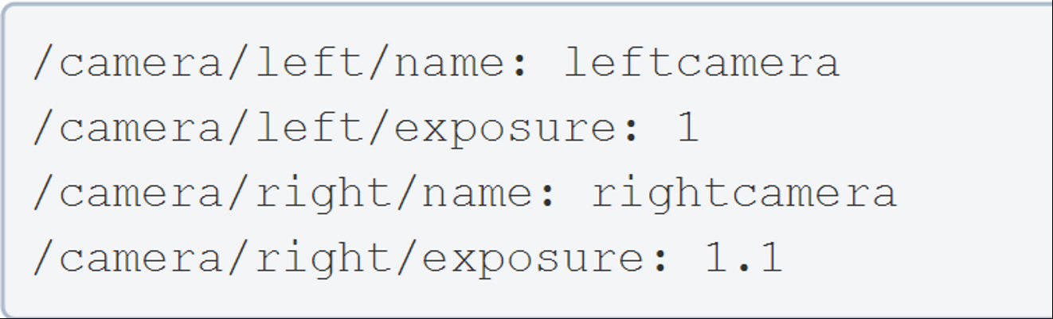
Parameter Names
Parameters are named using the normal ROS naming convention. This means that ROS parameters have a hierarchy that matches the namespaces used for topics and nodes. This hierarchy is meant to protect parameter names from colliding.

Slide 8
Rosparam
rosparam package contains the rosparam command-line tool for getting and setting ROS Parameters on the Parameter Server using YAML-encoded files.

Slide 9
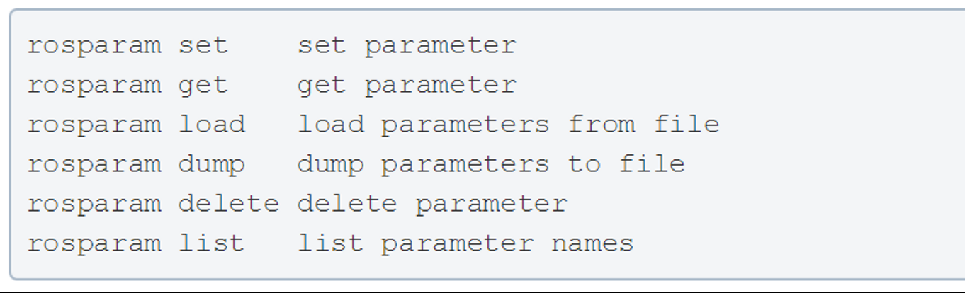
rosparam Command-line Tool

Slide 10
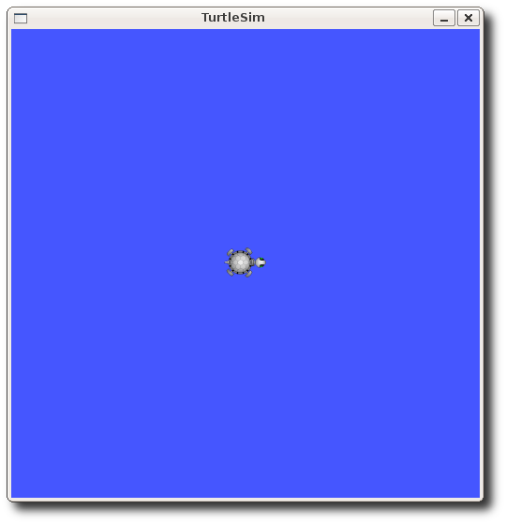
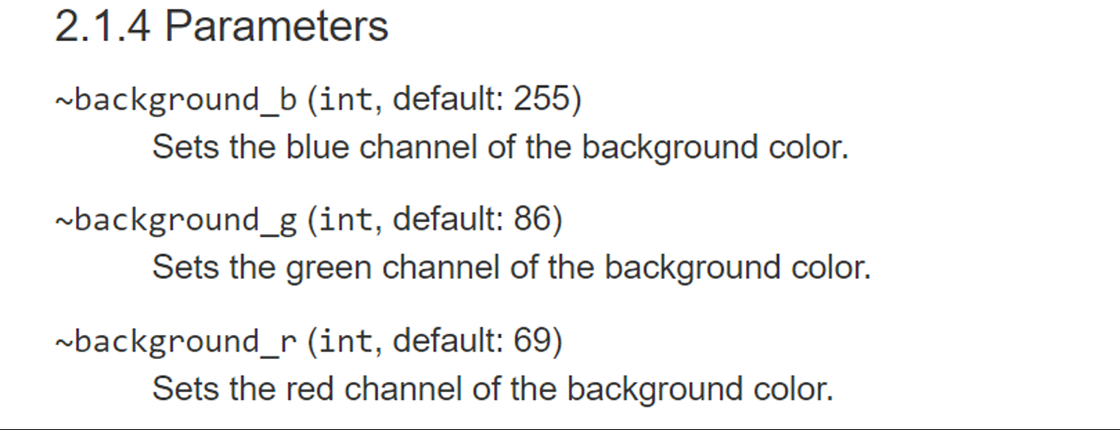
Example - Turtlesim

Slide 11
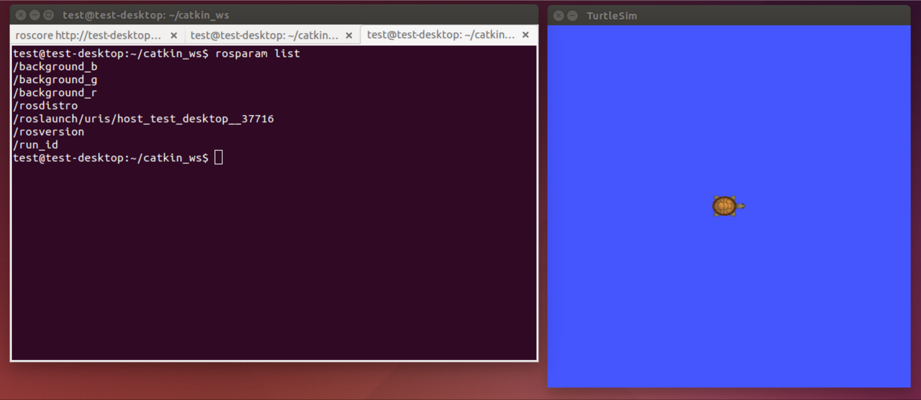
Rosparam list

Slide 12
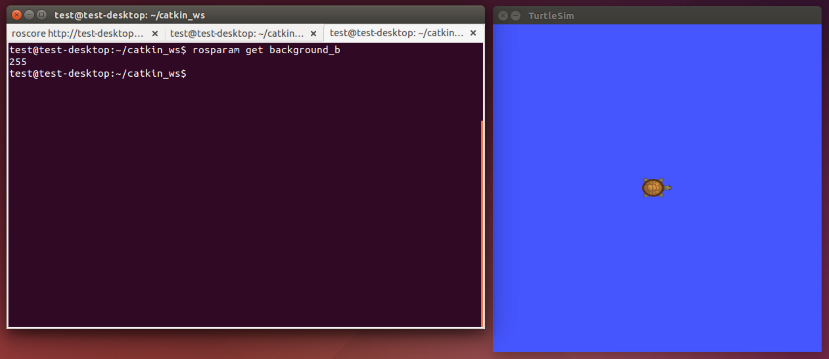
Rosparam get

Slide 13
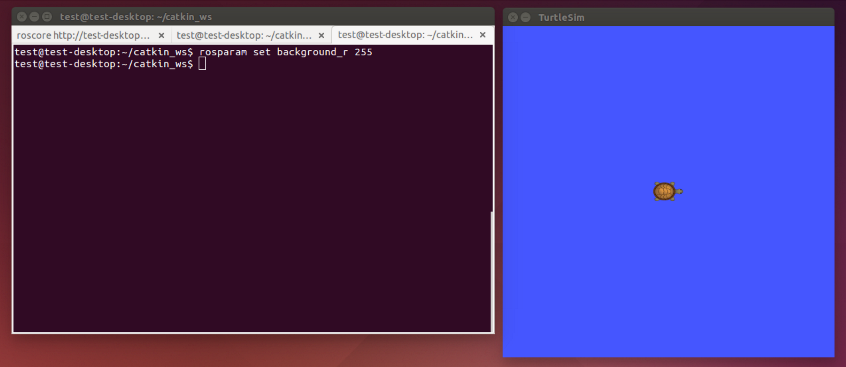




Rosparam set

Slide 14
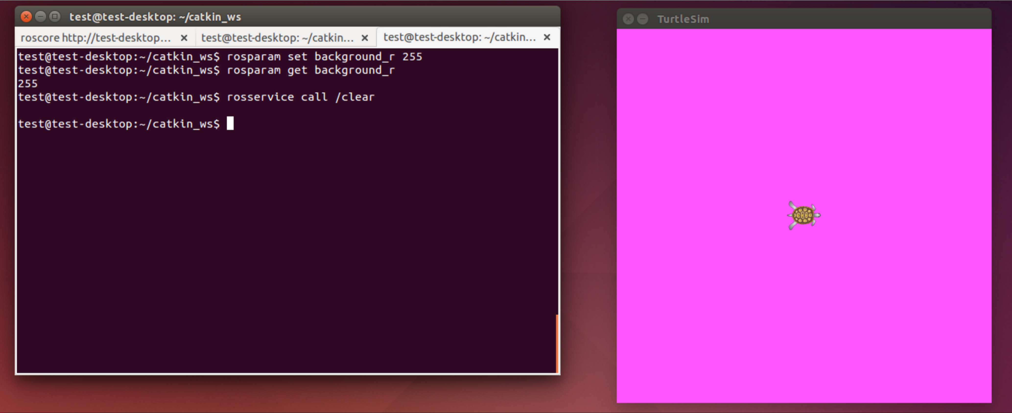
Rosparam set – rosservice call /clear

Slide 15
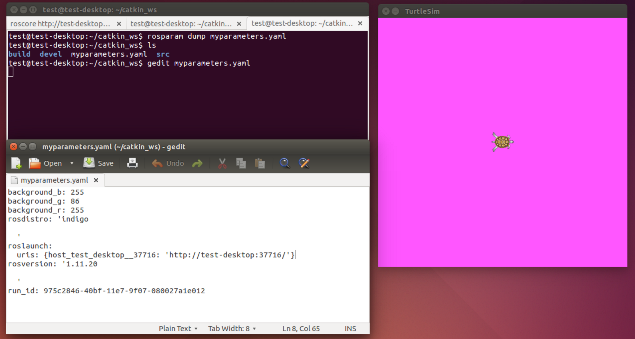
Rosparam dump

Slide 16
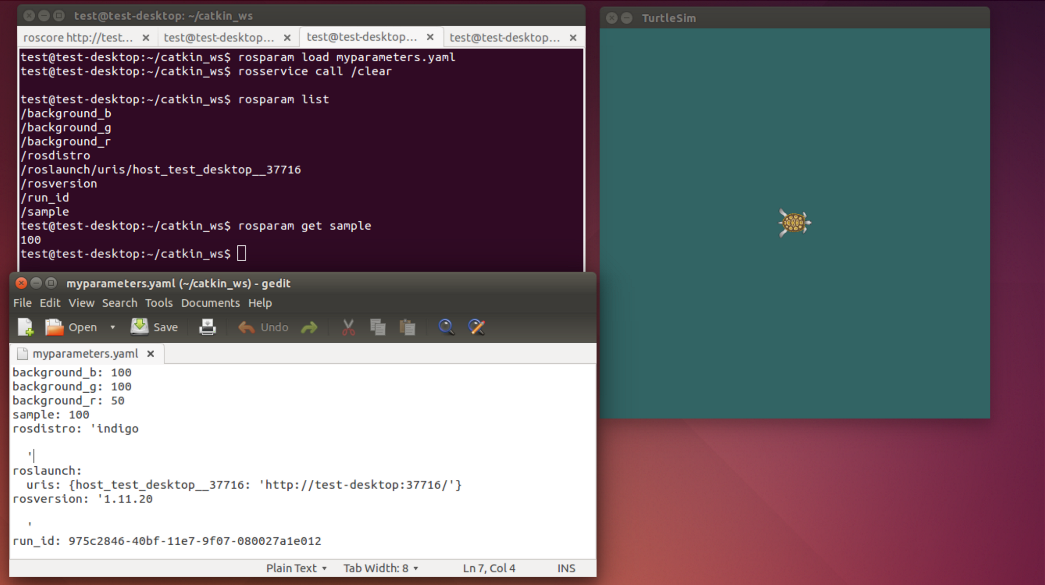
Rosparam load

Slide 17
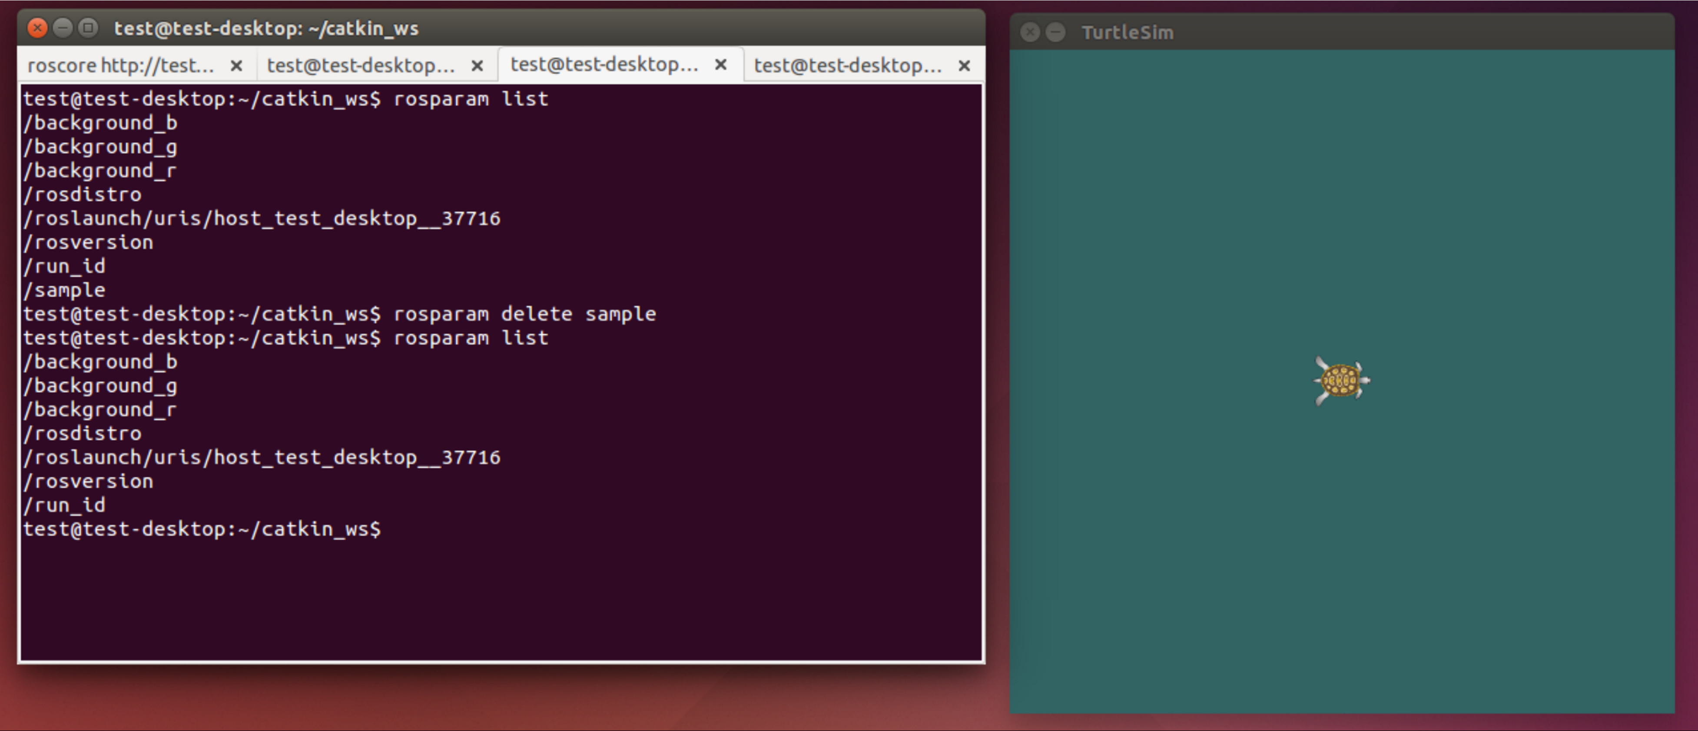
Rosparam delete

Slide 18
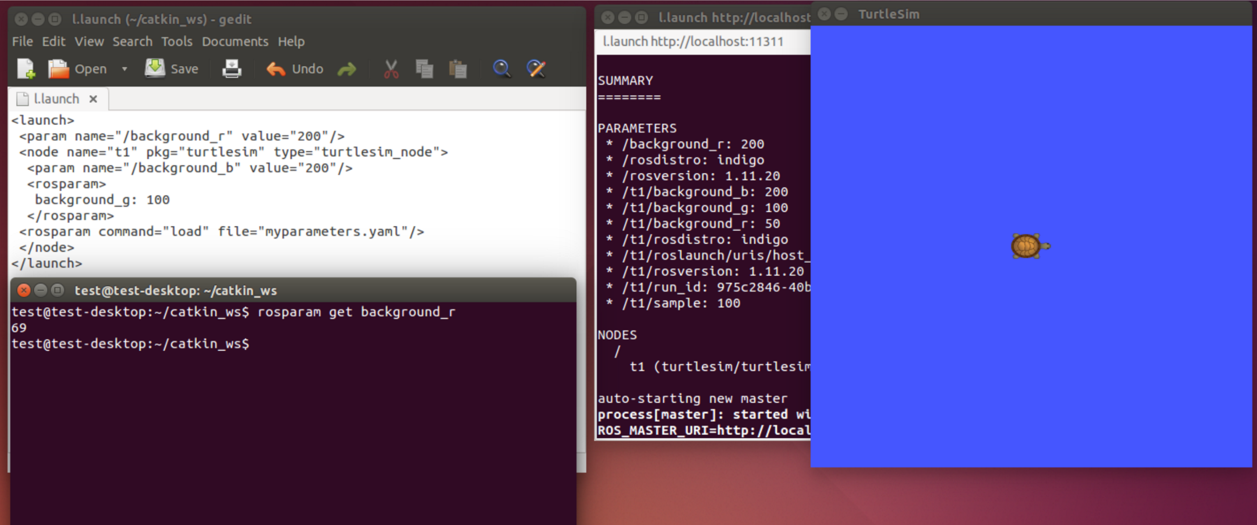
Using Parameter Server in Launch File

Slide 19
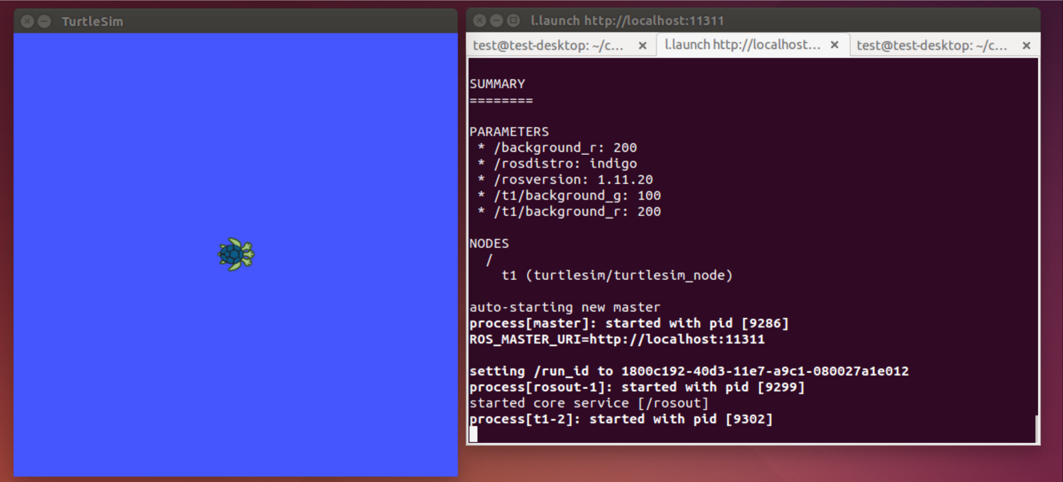
Launch file result

Slide 20
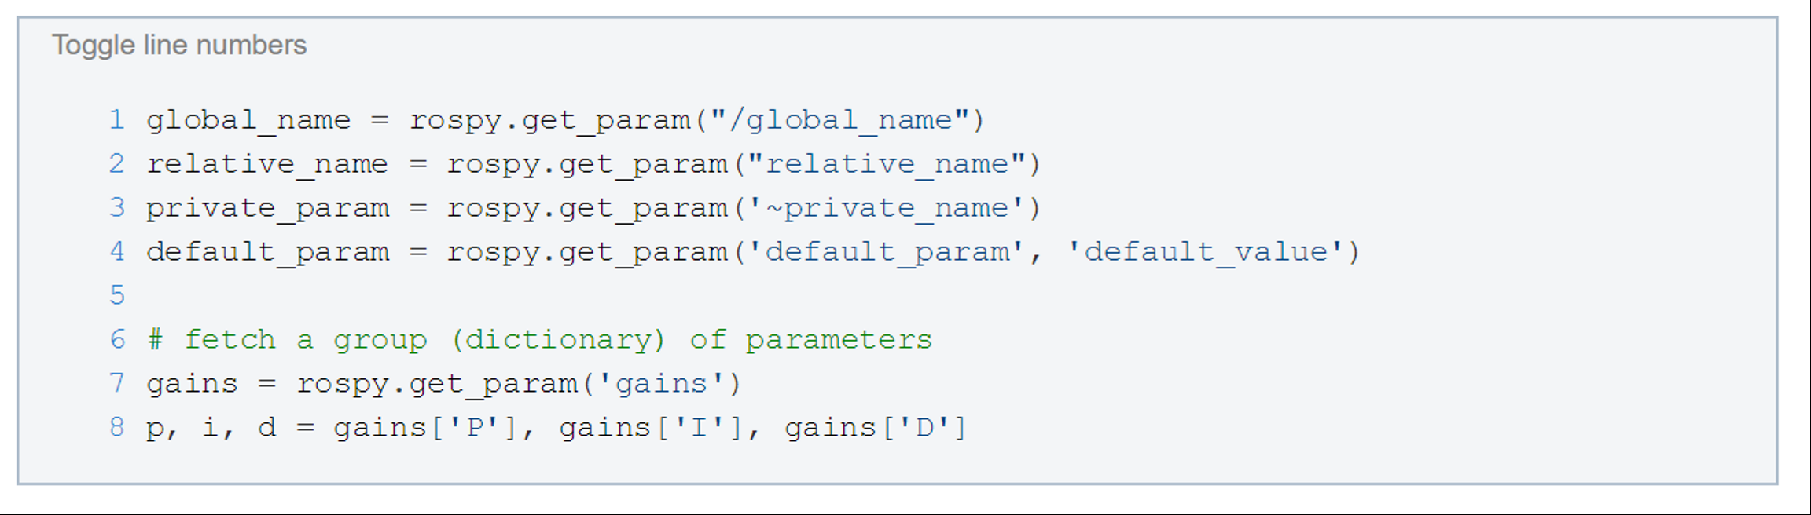
ROS Parameter in Python
Get Parameters:

Slide 21
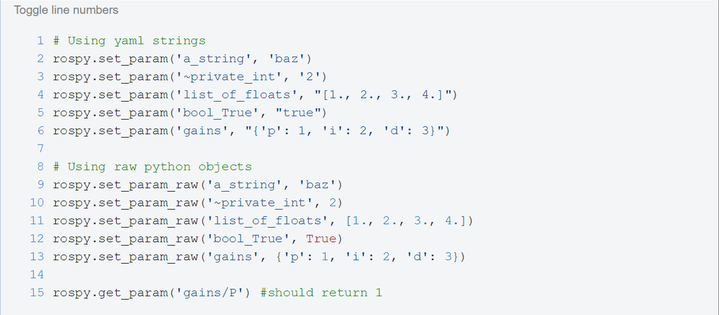
Set Parameters in Python

Slide 22
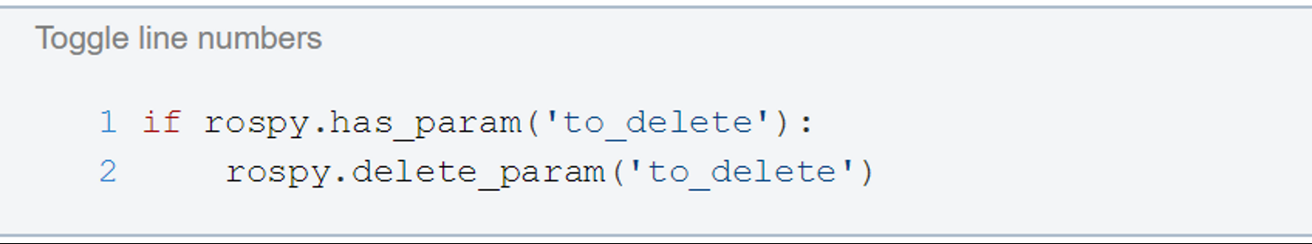
Check Parameter Existence in Python

Slide 23
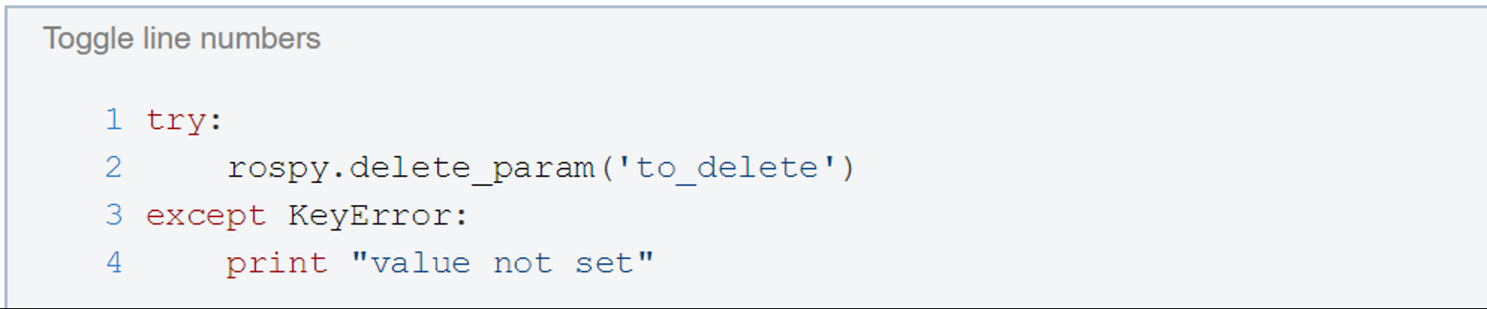

















Parameter Delete in Python

